Slide 1
Metadata (Speaker View)
Elevator Pitch
They said it was impossible. They said it couldn’t be done. They said they would never move our customized commercial off the shelf (COTS) application and move it into the cloud. They were not a Solution Architect. Learn what it takes to do the impossible and modernize your COTS development.
Description
They said it was impossible. They said it couldn’t be done. They said they would never move our customized commercial off the shelf (COTS) application and move it into the cloud.
They were not a Solution Architect.
This session we will go through nearly 3-year journey to move a customized, Oracle-powered, on-premsis COTS ERP, and move it to a cloud powered version of itself with modern development practices. We will review the good parts, the bad parts, and provide you with your own enterprise solution architecture cheatsheet to find success in the impossibly large tasks.

Slide 2
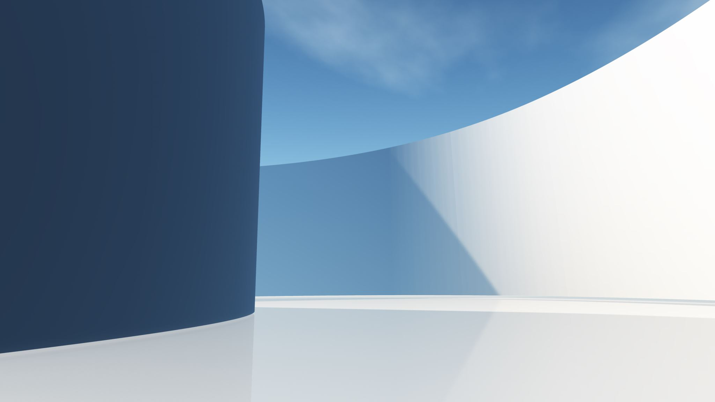
From Custom COTS to Cloud:
A Case Study in Solution Architecture
Prairie Dev Con 2022 // David Wesst
Notes:
What it is: Story time on applying non-coding solution architecture in the real world to make the impossible happen
What it isn’t: Technical patterns, leadership strategies, discussion on architecture frameworks

Slide 3
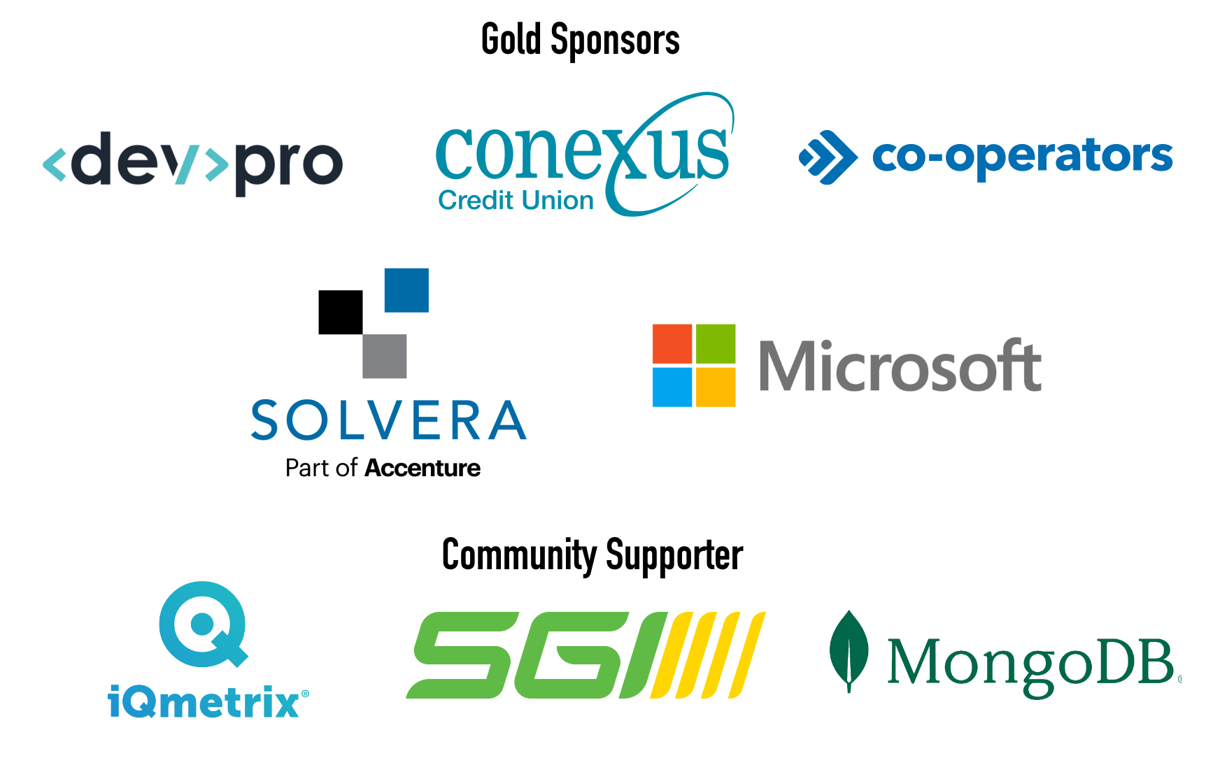

Slide 4

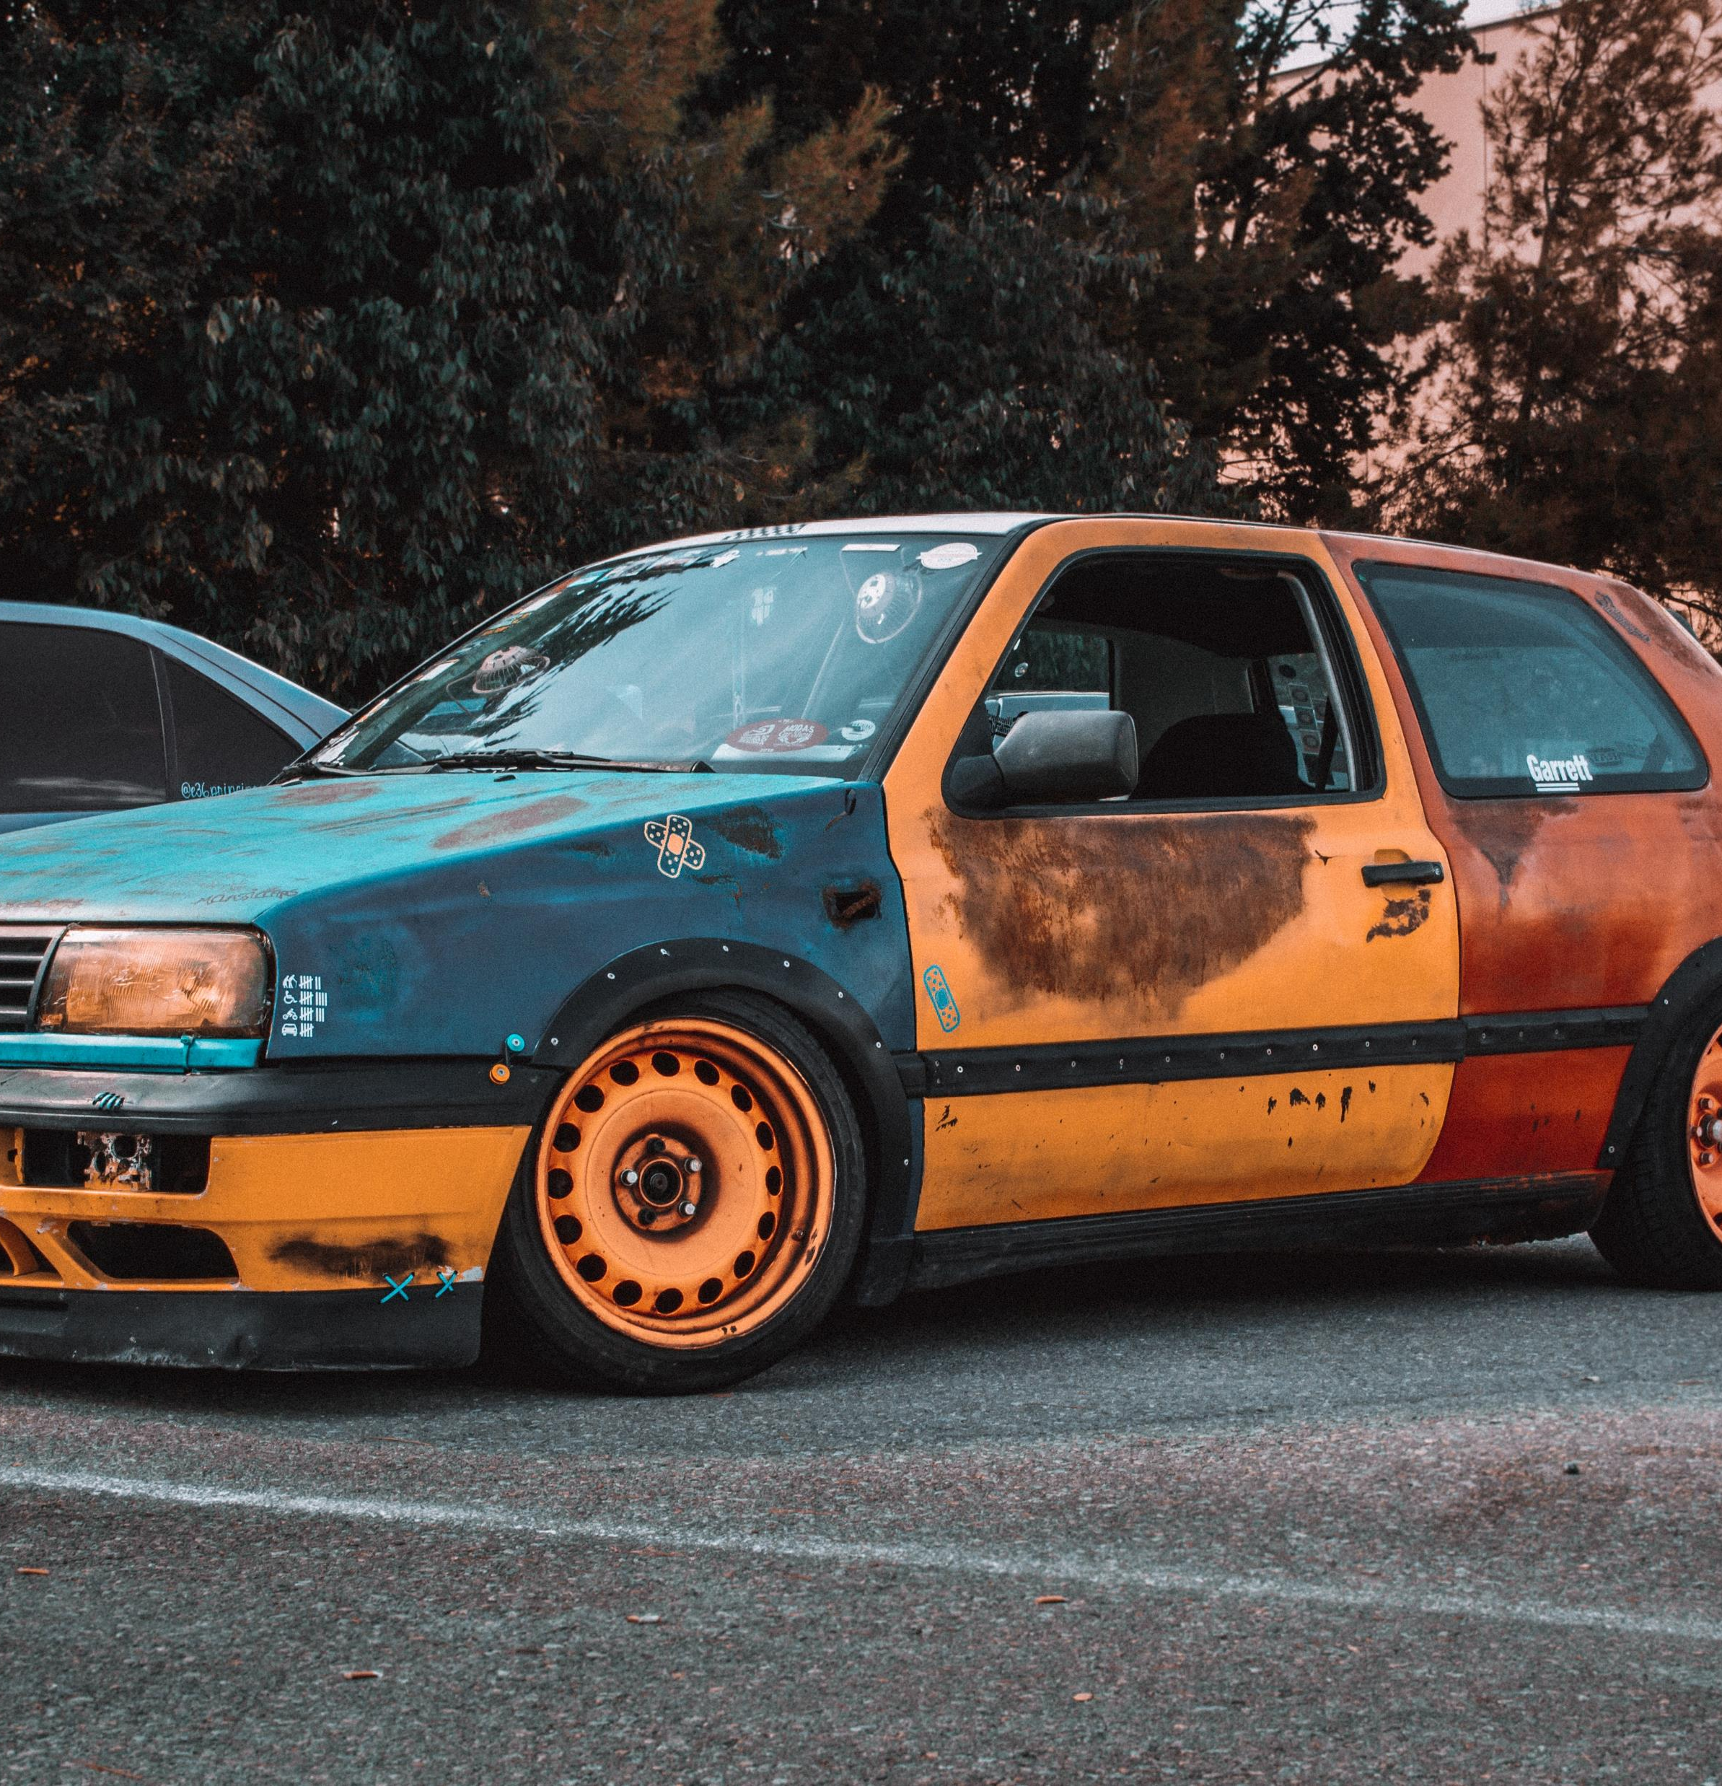
Notes:
Problem: Project-centric culture does not care about long term goals

Slide 5
Plan
Build
Run
Notes:
The idea is that projects are built, which are then maintained, which informs the plan for the next project…

Slide 6
COTS
=
Commercial Off The Shelf
Notes:
Define commercial off the shelf

Slide 7
In the 1990s, many regarded COTS as extremely effective in reducing the time and cost of software development. COTS software came with many not-so-obvious tradeoffs— a reduction in initial cost and development time over an increase in software component-integration work, dependency on the vendor, security issues and incompatibilities from future changes.
Wikipedia (October 2, 2022), https://en.wikipedia.org/wiki/Commercial_off-the-shelf
Notes:
Higher education is ~10 years behind the rest of the market

Slide 8
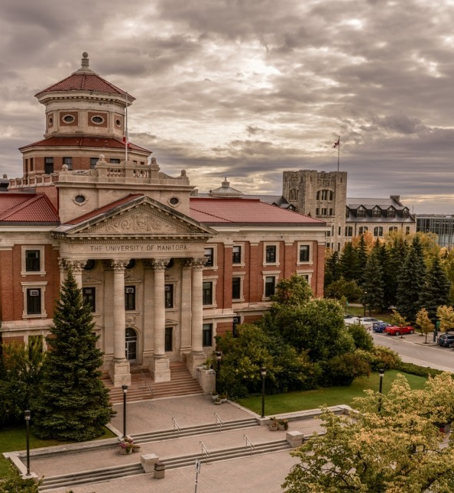

SaaS
????
Notes:
How do you get a long-lived project, like an ERP, to the cloud. Not just “cloud”, but SaaS cloud?

Slide 9
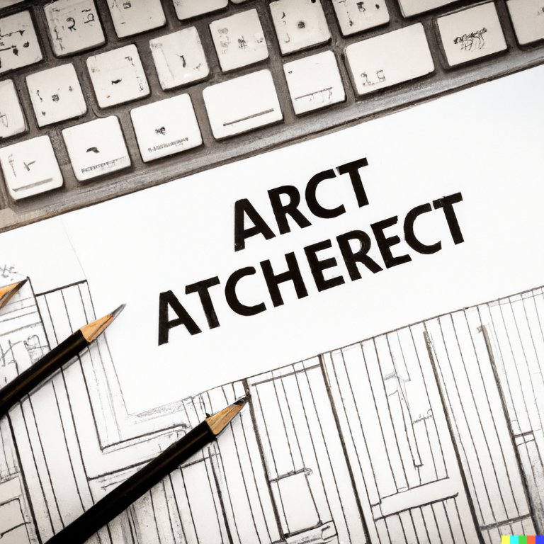
IT SOLUTION ARCHITECTURE
Notes:
Solution: Solution Architecture

Slide 10

Photo by Bob Fisher on Unsplash
Notes:
Today we will be talking about my brand of IT Solution Architecture

Slide 11

Summary
The Journey Custom COTS (Banner) to SaaS Cloud
How could you possibly even get there?
What did I do to help get us there?
Notes:
@ 8-10 mins

Slide 12
Takeaways (What I hope you learn)
Understand your Environment
Respect the Culture
Prepare for Opportunity
Change is Hard (Involuntary Change is Harder)
Progress is Progress
Build Trust, Acknowledge Risk, Practice Empathy
Customer-Centric Conversations

Slide 13

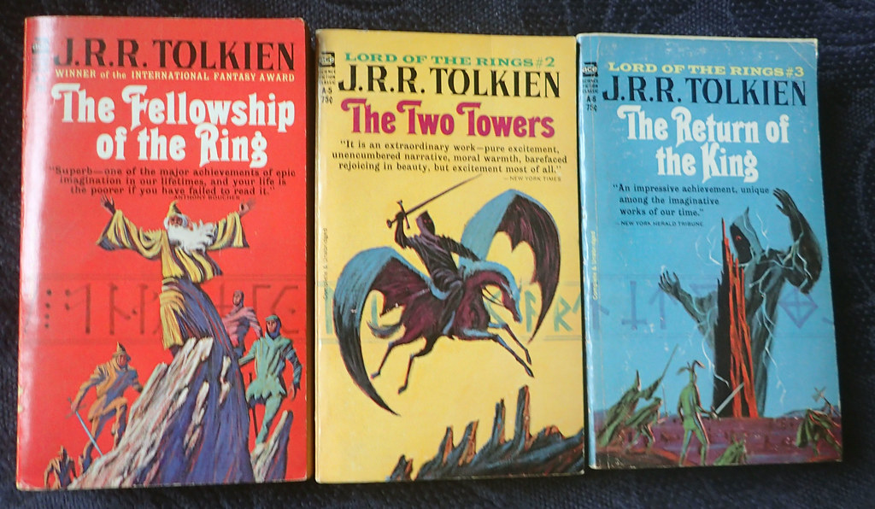
Outline
Part 0: Where it started…
Part 1: Where it changed…
Part 2: Where we went…
Part 3: Where we are going…
This Photo by Unknown Author is licensed under CC BY
This Photo by Unknown Author is licensed under CC BY-NC-ND

Slide 14

Where it started…
Part 0
This Photo by Unknown Author is licensed under CC BY-NC-ND
Notes:
Start, Aurora Launch in 2006
End, Banner 9, Phase 1
Mention IT driven change
Top-down orders
Merging Finance and SIS systems
Mainframe driven development to database-driven development
Define what Banner is (Admin Pages, SSB, built on a database)

Slide 15
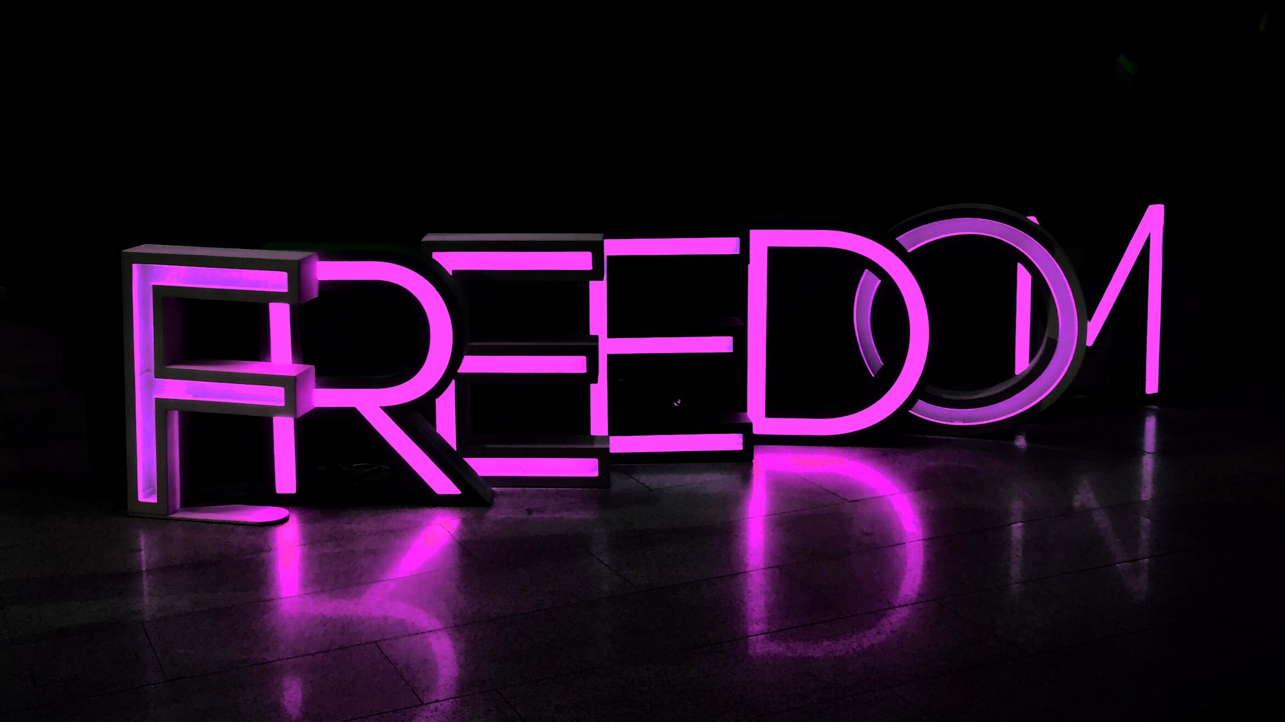
Photo by Kristina V on Unsplash
Notes:
The Culture is built on academic freedom and autonomy

Slide 16
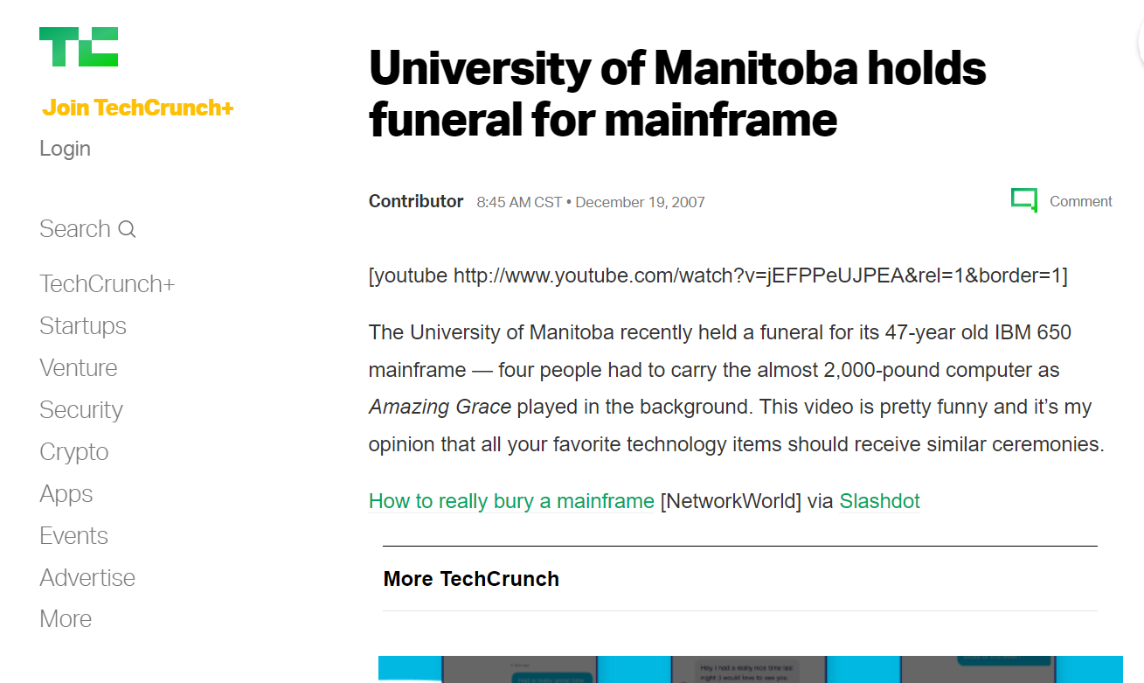
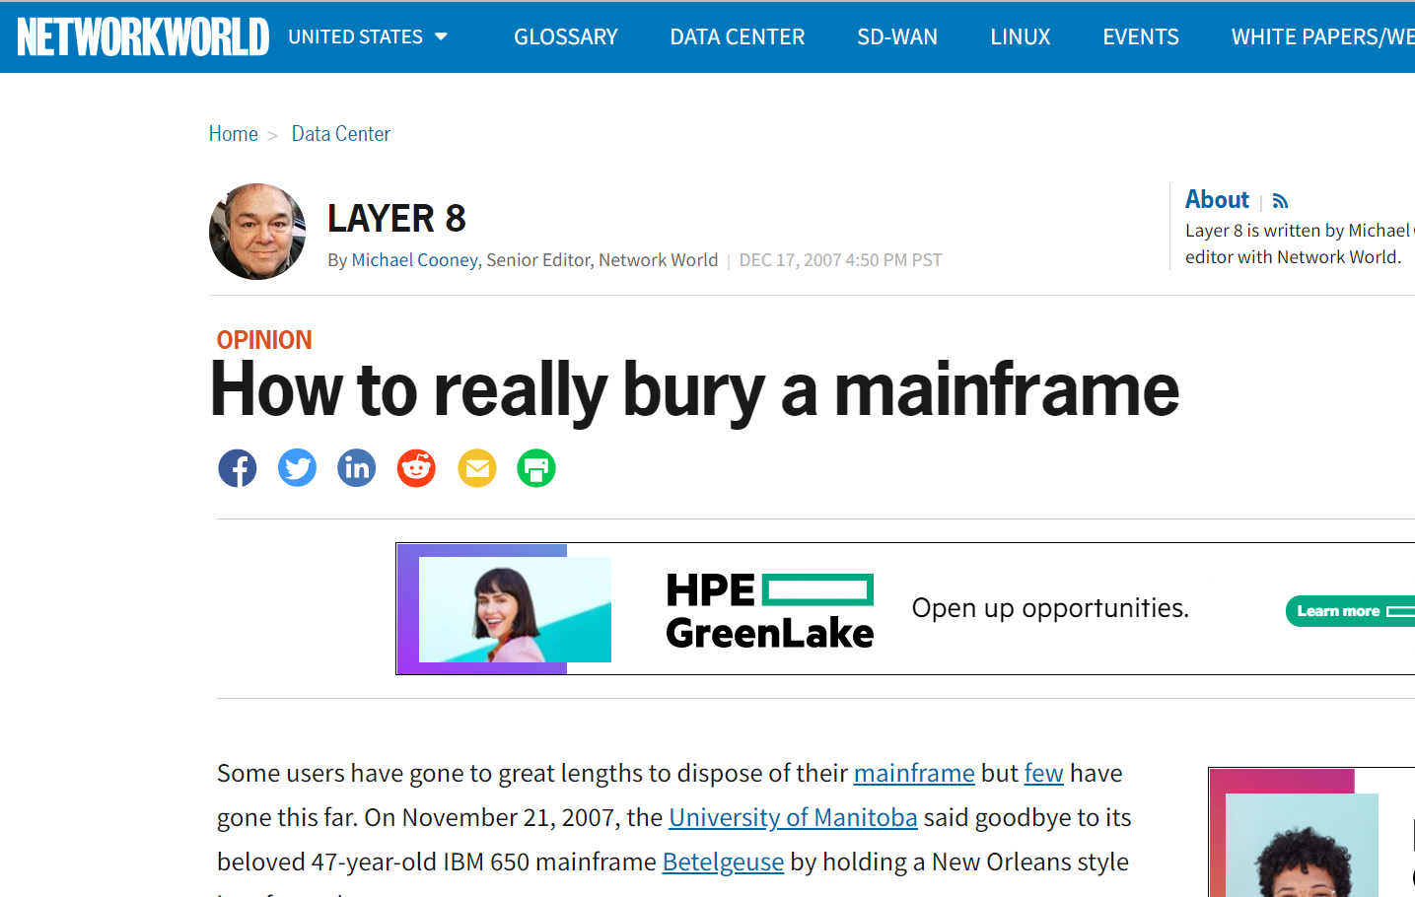

Slide 17
But now we must lay you under the flora, because we have to go deal with this bloody Aurora. So, we commit your parts to be recycled. Earth to Earth Ashes to Ashes Dust to Dust To the god of computers, please bless it and keep it And give it grace and peaceBut please do not resurrect it.
It leaves behind some 25 servers that are now needed to run these systems and will be lovingly remembered by users from across campus.
The IBM 650 was installed in the year 1960 and went through many upgrades and changes to the final hardware of an Amdahl Millennium 1015. In its many forms the mainframe has supported the Student Records systems, Payroll, Human Resources, Finance, Research, student labs, etc.
The users you were always able to please, with a little training they could enter with ease, all the data they needed in 2 or 3 screens instead of the 57 in VIP.
In Loving Memory of the Mainframe (aka IMS) (archive.org)
In Loving Memory of the Mainframe (aka IMS) (archive.org)
Notes:
Quotes from the “server funeral” website and eulogy

Slide 18


Notes:
Note the attitude of the TECHNICAL team (nevermind the BUSINESS team)
NOTE: The culture of autonomy and freedom

Slide 19

Leadership
Everyone Else
Notes:
This is the approach they took to change– change is HARD, but involuntary change is HARDER

Slide 20
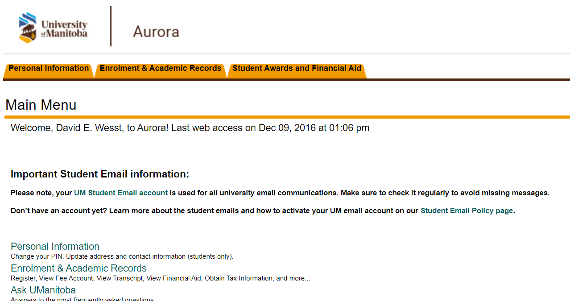

Notes:
And for this– it was to make the change that was needed.

Slide 21
Oracle Database
INB
Desktop Client
SSB
Web Client
Notes:
Describe the architecture of the application

Slide 22
Where it changed…
Part 1
This Photo by Unknown Author is licensed under CC BY
Notes:
@ 20-25 mins
Start, Banner 9, Phase 1
End, Banner 9, Tranche 2 “extended”
Database Driven Development to Application Driven Development (PL/SQL to Java)
Involuntary Change – Forced by vendor
Practice Empathy – Development practice changes
Missed Opportunity – Tranche 2 “extension”

Slide 23
Oracle Database
INB
Admin Pages
Desktop
Web Client
SSB
Web Client
Notes:
Describe how the architecture of the application will change

Slide 24
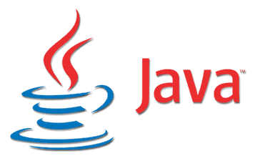

This Photo by Unknown Author is licensed under CC BY-SA
Notes:
Database Driven Development to Application Driven Development (PL/SQL to Java) for business logic

Slide 25
Leadership
Everyone Else
Notes:
Involuntary Change – Forced by vendor. Mention IT driven change
Change is HARD, but involuntary change is HARDER

Slide 26

Photo by Annie Spratt on Unsplash
Notes:
Development practice changes after 15 years of being a hero and committed to the pattern the vendor recommended
NOTE: Build Trust, Acknowledge Risk, Practice Empathy

Slide 27

Photo by Joshua Hoehne on Unsplash
Notes:
Because we weren’t the bad guy, we could start to rebuild trust
NOTE: Build Trust, Acknowledge Risk, Practice Empathy

Slide 28

Notes:
NOTE: Be Prepared for Opportunity
We “missed” the change to make more change (DevOps)– did not respect the environment
The org “missed” the change to get ahead with the rest of it

Slide 29
Where it went…
Part 2
This Photo by Unknown Author is licensed under CC BY
Notes:
@ 35-40
Start, Banner 9, Tranche 2 “extended”
End Banner 9 maintenance mode announcement (2022) / Banner Re-Implementation
Mapped technical risk to business capabilities
Inventory of customizations and integrations
Increased speed of release cycle
Rebuilt trust with business units
Went from keeping the lights on, to enabling the business (customer-centric mentality)
Educating Customers about “bad” customization

Slide 30

This Photo by Unknown Author is licensed under CC BY-NC
Notes:
I join as Solution Architect (Cloud) as I learned from my mistake and needed to have conversations at a higher level

Slide 31
Notes:
What does it mean to be SaaS cloud-first? It means no customizations

Slide 32

Notes:
Having customer-centric conversation about where “cloud-first” fit into their world and understand what it meant to be “cloud-first” in the big picture
NOTE: customer-centric conversations to build trust

Slide 33
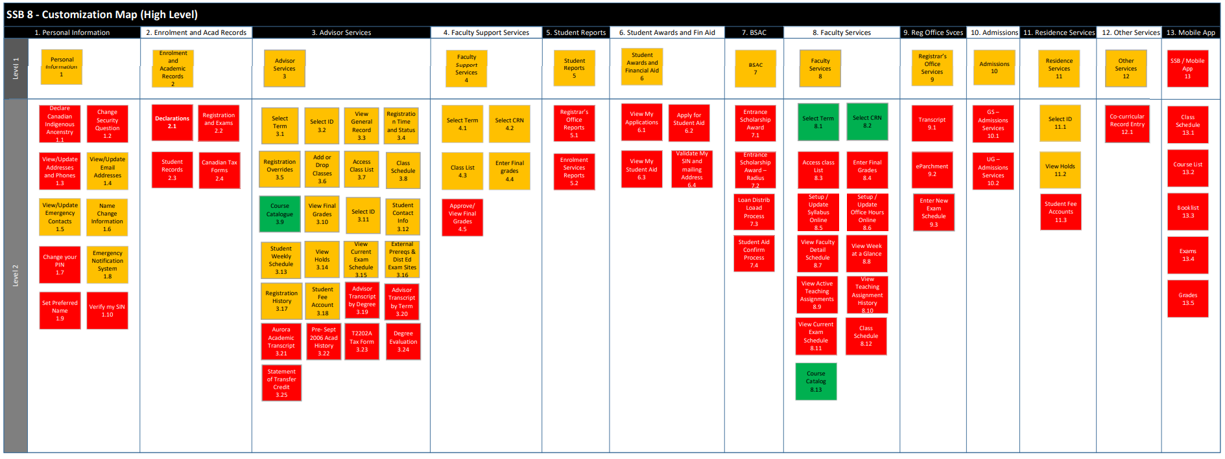
Baseline
Modifications
Customizations
Notes:
Starting doing an inventory of the digital moments / use cases / user stories and mapped them to customizations

Slide 34
Notes:
Better understanding of our integrations in and out of the Banner database

Slide 35
Photo by Joshua Hoehne on Unsplash
Notes:
Because we weren’t the bad guy, we could start to rebuild trust
NOTE: Build Trust, Acknowledge Risk, Practice Empathy

Slide 36


Notes:
Increased speed of release cycle (process is progress)
Refreshed how to do support (environment)

Slide 37
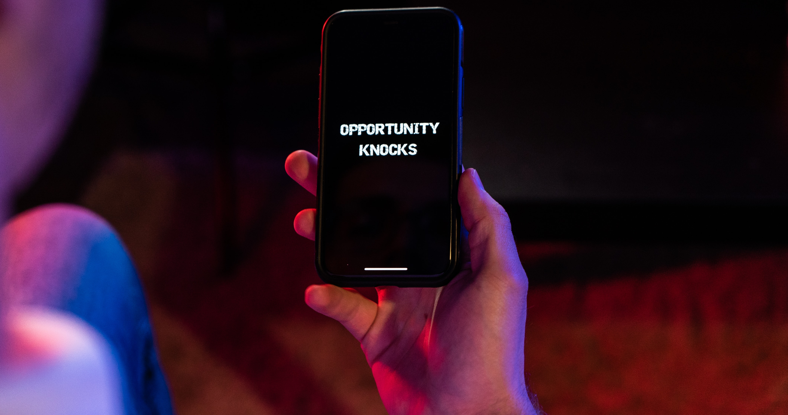
Photo by Dylan McLeod on Unsplash
Notes:
All of this so we can be prepared to capitalize on the opportunity, because it WILL come and we know it.
We = Business AND Tech teams

Slide 38
Leadership
Everyone Else
Notes:
….and then it happened again

Slide 39
Oracle Database
INB
Admin Pages
Desktop
Web Client
SSB
Web Client
Notes:
Going from this architecture…

Slide 40
Oracle Database
INB
Admin Pages
Desktop
Web Client
SSB (vNext)
Web Client (vNext)
GraphQL API
Notes:
To this architecture

Slide 41
Where we are going…
Part 3
This Photo by Unknown Author is licensed under CC BY
Notes:
@ 45
Banner Re-Implementation
Capability Driven
Cloud Ready / Cloud-First
Minimal Customization
Refactored / Rewritten Database Integrations
Assume a “No Database” approach

Slide 42
*sorta
Notes:
Going Cloud-Ready, not all the way cloud SaaS

Slide 43
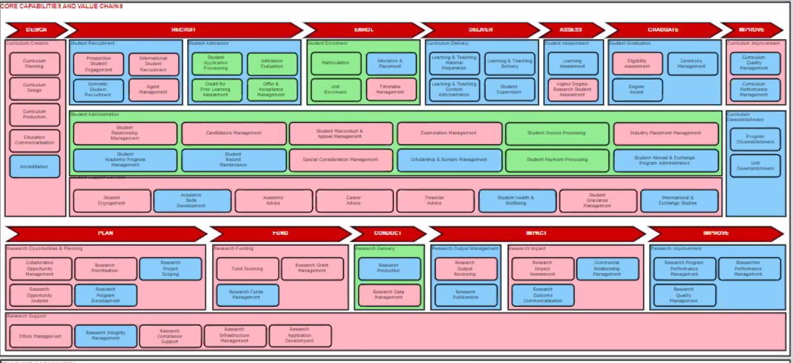
U of M Capability Map Concept
Notes:
NOTE: Identify risk using customer-centric conversations

Slide 44
Estimated number of features for Phase 1 – Student Experience
Personal information management
14 user features
Enrollment and Academic Records
61 user features
Student support/Advisor management
30 user features
e.g. change emergency contact information
e.g. search for classes available in Fall 22/23
Estimated Total – 105 user features
SSB Gap Analysis_2022_v2.xlsx
Notes:
Capability Driven, on a micro-level to start
NOTE: Customer-centric conversations

Slide 45
Baseline
Modifications
Customizations
Notes:
Applying the education that customizations are bad, but understand that we may STILL need some for the customer

Slide 46
Program Overview - DRAFT
Phase 1 –
Student Experience
Focused on moving and modernizing the current Student Experience from SSB 8 to SSB 9 + Experience + Advisor experience enhancements
Phase 2 –
Faculty and Staff Experience
Focused on moving and modernizing the current Staff & Faculty experiences from SSB 8 to SSB 9 + Experience + Workflow + Reporting
Phase 3 –
Integrations
Modernize and streamline over 100 integration points into Banner
Technology refresh:
BDM, Ethos, Infrastructure upgrade, Workflow, Email authentication
Notes:
Notice the “technology refresh” spans the whole program
Applying architecture governance

Slide 47
Planning Approach 1/2 – DRAFT
This is our focus for year #1
Phase 1
Rolling wave Planning
Disposition
Student experience development
Phase 2 & 3
Technology Refresh
Checkpoint #1
Checkpoint #2
Checkpoint #3
Checkpoint #4
Go live
Rolling Wave planning
  There are too many gaps to create a detailed plan upfront
  As the project team work to identify details, plans will be updated helping solidify the development of each of the program phases.
Roadmap
  Develop a high-level roadmap with target delivery dates for Phase 1 & Technology Refresh.
  Roadmap will be refreshed for every checkpoint
Notes:
Enable flexibility within the program because we ready for the opportunity

Slide 48
Proposed Program Governance
Program Board
Executive Sponsor
Senior Sponsor
IST Sponsor
Program Manager
ORES Directors
Architect
Implementation Leadership
Program Manager
ORES Directors
Architect
OCM Lead
Business Analyst
Scrum Lead
Functional Leads
Technical Leads
Project Team
SWAT Team
Functional Team
IST Team
Notes:
Project is lead by customer, supported by IT
IT Architecture is represented at the top layer

Slide 49
Notes:
Then– when the product is fleshed out and ready, we can go SaaS when the business wants it (not IT)

Slide 50
Takeaways (What I hope you learn)
Understand your Environment
Respect the Culture
Prepare for Opportunity
Change is Hard (Involuntary Change is Harder)
Progress is Progress
Build Trust, Acknowledge Risk, Practice Empathy
Customer-Centric Conversations

Slide 51

Questions
& Contact Info
David Wesst
University of Manitoba
david.wesst@umanitoba.ca / dw@davidwesst.com

