Slide 1
Session Details (Speakers Only)
Elevator Pitch
  This session explains the weird and bizarre world of IT architecture. You will learn about the role an IT Architect and they work together navigate the enterprise to achieve the impossible of creating consistency across multiple business units with different goals.
Description
  IT Architecture practice is a different kind of tech role. You code less (or not at all), you have more meetings, you write a lot of documents, draw a lot of pictures, and have no real authorityover anyone or anything. Yet as bizarre as this role sounds, we continue to see more and more organizations create their own architecture practices to align their technology teams and forge a unified path forward.
  In this session, you will learn about the role of IT Architecture in an organization and how IT architects work together navigate the enterprise and create consistency across multiple business units with different goals.
Notes
  This is a session focused on explaining enterprise and solution architecture, from both the role of the architect and that of the practice lead. It targets people thinking about getting into architecture and leaders considering the value that enterprise and solution architecture practices can bring to their organization.

Slide 2
Outline (Speakers Only)
Goal: Explain the role of “Enterprise Architecture” and the problem that it solves.
Problem: Aligning ALL technology initiatives to a continually evolving and changing business strategy
Solution: IT Architecture practice

Slide 3
Outline
Defining the Problem (and Solution)
Describing Our Environment
  POINT: Every environment is different, the goal is to embrace your culture and learn to apply EA with the constraints
  What are our constraints?
    BU Independence
    Project Driven Finances and Structure
Where we are today
  How we define strategy (Terry)
  How we implement the strategy (David)
  How we iterate and inform on the strategy (Terry & David)
The Next Steps
  Extended IT Architecture Board
  Program Governed Projects

Slide 4

Consensus in the Chaos
The Role of IT Architecture
Terry Bunio // David Wesst
Prairie Dev Con 2022 [Regina, Winnipeg, Calgary]

Slide 5
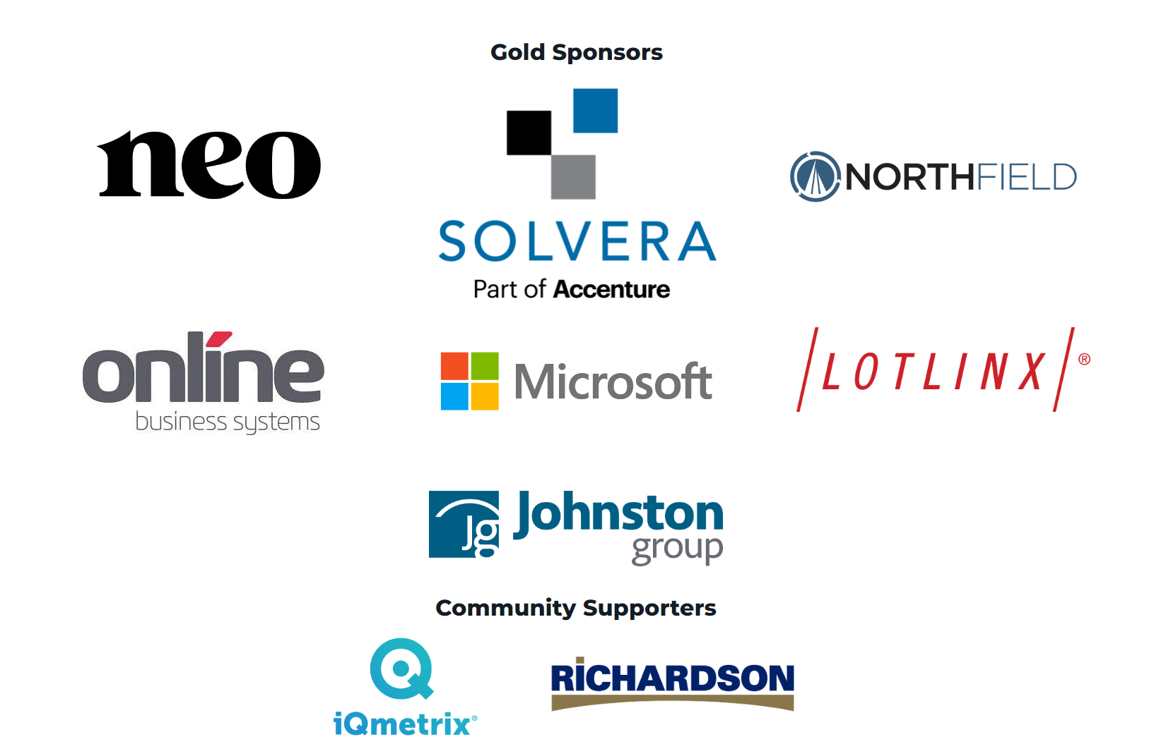

Slide 6

Notes:
The Problem: Aligning Tactics with Strategy
- Strategy (or Vision) set by leadership (I.e. CxO, VPs, important initials)
- Tactics are supposed to execute on the strategy
- But how are you supposed to align multiple tactical initiatives (e.g. projects, products, programs) to a strategy when it changes every few years with a change in leadership

Slide 7
The Solution: IT/Enterprise Architecture
Leadership
Program
Project
Project
Product
Project
Project
Project
Vision
IT Architecture
Implementation

Slide 8
The Solution: IT/Enterprise Architecture
"Enterprise architecture (EA) is a discipline for proactively and holistically leading enterprise responses to disruptive forces by identifying and analyzing the execution of change toward desired business vision and outcomes"
--> Gartner Definition (September 8, 2022)
Fancy way of saying, we help navigate and change course

Slide 9

We help steer the ship

Slide 10
Why are we all here?
Us
You
To explain what IT Architecture is, using a real-life example: Us (University of Manitoba).
To learn why IT architecture is a thing and how it can be applied on a micro, day-to-day level

Slide 11
How will we do this?
By showing you how we practice Enterprise Architecture at UManitoba today, and how we intend to continue to evolve that practice
We will walk you through our current framework for EA from the top down (leadership), and from the bottom up (solution architect)

Slide 12
What is IT Architecture?
Terry

Slide 13

The University of Manitoba campuses are located on original lands of Anishinaabeg, Cree, Oji-Cree, Dakota and Dene peoples, and on the homeland of the Métis Nation. We respect the Treaties that were made on these territories, we acknowledge the harms and mistakes of the past, and we dedicate ourselves to move forward in partnership with Indigenous communities in a spirit of reconciliation and collaboration.

Slide 14
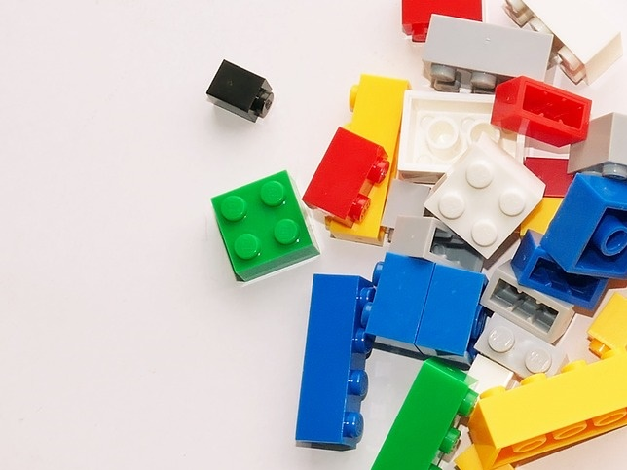
What is
IT Architecture?
Pieces don’t put themselves together in the right way all the time.
      We do IT Architecture because certain qualities do not just arise when you put one functional component next to the other. Architecture tries to achieve sustainability, dependability, scalability, performance, which are many of the things you do not get right the first time you design a system.
      http://www.opensecurityarchitecture.org/cms/definitions/it-architecture

Slide 15

Design the Kitchen
Ever worked in a wonderfully laid out kitchen? That layout is not an accident.
      A kitchen is comprised of many functional components: a sink; stove; fridge; workspace; storage; etc.
      When put together one way the efficiency of work done in the kitchen is much higher (and more enjoyable) than if the components were arranged another way.
      So it is with systems.

Slide 16
Three Part
Conversation
      Traditionally, conversations about solution are often focused on the right solution right now: how IT can meet the particular need of the department, unit or faculty.
      IT Architecture ensures a place at the table for the wider need and value to the University.
      In many conversations this perspective can be missing. This third perspective ensures that the overarching success of the institution and the wider value and benefit of any given solution is considered and given weight.
Architects add the Institutional perspective to conversations.
University
Solution
Unit / Faculty
IST

Slide 17

The IT Architect a profile
      The Architect…
      Sets technical direction.
      Establishes standards.
      Plans with a view to the strategic context.
      They…
      Provides technical leadership on projects.
      Own the technical solution
      Put the solution into context
      Frame decision options and recommend approaches
      Plan for long term fit, operation and evolution of systems and environments
      They think in term of roadmaps, models, frameworks, patterns, capabilities, trade-offs
      They are planners, designers, integrative thinkers, pragmatic purists
      Their focus is standardization and Integration
      With a view to balancing competing interests and highlighting risk and costs.
      These technical leaders have a breadth of understanding of the organization coupled with deep technical expertise.
      They are integrative thinkers that pull together technical and business domains.
      They think with the big picture in mind, so that solutions will not only be the right solution, right now, but also the right solution long term and in the context of the whole technical ecosystem.
Architects are T-Shaped people: they have breadth and depth.

Slide 18


Expert Guidance
Architects help decision makers make decisions.
      Architects are the big-picture thinkers who are looking at all the pieces to see how they fit together. They observe the state of change to see how the pieces will need to fit together in the future.
      Because they know the technology, the roadmaps, trade-offs and implications they can provide strategic advice to decision makers across the institution. This expert guidance can be vital when charting the course of departments, faculties, units and the institution overall.
    Recommend
      Architects don’t just present options, they recommend direction. Architects know the business context and understand the trade-offs enough to present a preferred solution from amongst the options.

Slide 19

Technical Direction
      Sometimes projects or initiatives may veer off in a different direction (for lots of reasons), and there is lots of in-place systems and technology that make the path more challenging. But the architects take the long view to look at where we ultimately need to end up.
      Architects set technical direction. These are the big picture thinkers that get up and out in front to say “here is where we are going”. They look at the technology and the business needs and create a roadmap that gets us to where we need to be. They position the institution well for the future through applied innovation.
Up and out. Figure out where we are going and plant the flag so we can all get there.

Slide 20

Core Competencies
The University has identified 9 architecture competencies that we focus on developing and improving over the next three years. These are areas that we believe will be critical to run our environment and support the mandate of the institution. While architects are generalists that need to know a lot about a lot, no one knows everything. These are areas that architects may go deep on.
Skillsets and expertise that we will focus on within our practice
    Network
      The infrastructure that connects us and enables communication.
    Data/BI
      Understanding, managing and using our information.
    Integration
      Connecting the pieces together to create a seamless experience across systems and business units.
    Application
      The software tools that we use to do the work we do.
    Cloud
      Taking advantage of cloud technology for our environment.
    Security
      Control and protect our environment.
    Mobile
      Solutions and infrastructure to support mobile devices.
    AV
      Audio visual solutions for teaching, learning and business.
    Server/Storage
      The compute and storage to run our systems including research and high performance computing.

Slide 21
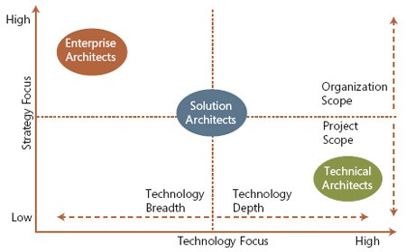
IT Architecture
The Roles
    Enterprise Architect
      The Enterprise Architect (EA) is a planning and leadership role that is responsible for identifying the future state of the organization’s IT environment -- in the context of the business strategy -- and engage wherever and whomever necessary to help guide the organization to deliver toward it. This is a transformation role that looks at future-state. Where are we going and why.
    Solution Architect
      The Solution Architect (SA) or Systems Architect is the technical lead on projects. They are responsible for designing a high level solution to a specific set of business requirements, within the organizations architecture framework. This solution may span multiple applications or technologies.
    Technical Architect
      The Technical Architect is a technology specialist in a particular technology or group of inter-related technologies. They are responsible for implementation of, and processes within, a specific technology, application or suite of applications. They have deep knowledge in a particular competency (or set of competencies) and will often be consulted by other architects as part of a larger solution.
There are three key roles that architects play, that speak to strategic focus vs technological depth.

Slide 22
IT Architecture Practice the journey
      Commitment of 6 positions by CIO in 2016
        Design and Architecture done informally prior to this
        Recognized need to provide more focus, expertise, and continuity
      Architecture Board formed in 2018
        Reviews Architecture Visions, Architecture Decision Requests, and standards
        Meets bi-weekly
      Current Team
        Banner Program Architect
        Identity Architect
        Data Architect
        Infrastructure Architect
        Solution Architect
        Infrastructure/Network Architect
        Director, Planning and Governance (Non-voting member)
      Up to this point we have been a responsive practice that responds to projects/initiatives
How did we get here?

Slide 23
IT Architecture and Project Teams
The Solution Architect is the technical lead on projects and owns the solution. This complements the PM who owns process and the Business Lead who owns the benefit.
A project is any piece of time boxed work. Some projects require formal governance and formal project structures, other smaller pieces of work can still follow project methodologies.

Slide 24
IT Architecture Practice the conflicts
      Project Board controls scope/budget of projects
      Architects present design and recommendations to the Project Board based on expertise and experience – not considering budget
      Many times the recommended solution may not be able to fit in scope/schedule/budget of project
        Significant exceptions require the Project Board to request an Architecture Exception that needs to be approved by CIO
        In 4+ years we have not had an exception request
      Our primary challenge is we integrate rather than develop
        Our list of preferred solution/integration options can be limited
So what do we do when people don’t agree?

Slide 25






IT Architecture
Themes
Standardization
Integration
Capabilities
g
At U of M, The Architecture practice focuses around 7 major themes.
Innovation
Trade-off
Roadmap
Execution

Slide 26

trade-offs: Risk
What architects worry about so you don’t have to.
      Technical risk, product risk, delivery risk. Will the solution perform and evolve as needed. These are things that architects worry about. They look beneath the surface to find the issues that really matter.
      Architects focus on the product (solution) risk, while PM focus on the project risk.
      Risks can be addressed by quality which is often described in the ‘ilities’: Usability, Stability, Availability, Reliability, Scalability, Maintainability, Extensibility, Portability, Security(ility), Privacy(ility)

Slide 27

Roadmap
The roadmap is a cornerstone deliverable of IT architecture. It is an articulation of the destination and the path to get there.
    Destination
      To determine where we are going, architects need to consider the whole context of where we are, the needs of the institution now and in the future, the technology and business resources we have now and may have in the future, the trade-offs of cost and risk, the capabilities we have, and those we want to have. Considering all this and more they work with the business to define where we want to be.
    Path
      The old saying “its not the destination, it’s the journey” rings true here. How we get to where we want to be is as important as where we want to be. The trajectory that we need to follow to hit our target is never a straight line from A to B. The technology and business changes required - the waypoints on the road – are critical because they address the business and technical ability to adapt to the change: the speed at which we can inject innovation into the institution.
      Architects make the roadmaps that we follow as we evolve our ecosystem in both terms of business capabilities and technical infrastructure.
      However, architects recognize that, while the plan is necessary but not sufficient.
    The general who wins a battle makes many calculations in his temple before the battle is fought. The general who loses a battle makes but few calculations beforehand. Thus do many calculation lead to victory, and few calculations lead to defeat.
    – Sun Tzu, the Art of War
    Plans are nothing; planning is everything.
    - Dwight D. Eisenhower
B
A

Slide 28
The Purpose of IT Architecture
      Capture, connect and visualize the University’s information technology ecosystem in a way that allows for meaningful planning and informed decision making.
      Through standardization and integration, promote an information technology ecosystem focused on, and enabling of , business capabilities.
      Articulate the path using roadmaps that moves the technology ecosystem and institutional capabilities forward, applying innovation and balancing trade-offs.
      Provide technical direction and leadership though establishment of standards, solution design and project execution.

Slide 29
IT Strategy/Architecture Next Generation
1
Strategic Capability Map
2
Strategic Technology Map
0
Project Based
1
Institution Capabilities
2
Technology Capabilities
0
Project Success

Slide 30
IT Strategy/Architecture Technical Capabilities
Digital Moments
Jobs to get done
Strategic Technology Maps

Slide 31
How do we practice IT Architecture?
David
Notes:
Appreciate the framework, but “how does it work”? To do that, we need to understand the nuance of my nice (higher education)

Slide 32

Photo by Hans Reniers on Unsplash
Notes:
University Culture Overview
Our product output is research, which demands autonomy. Example lead researcher deciding how to do research

Slide 33
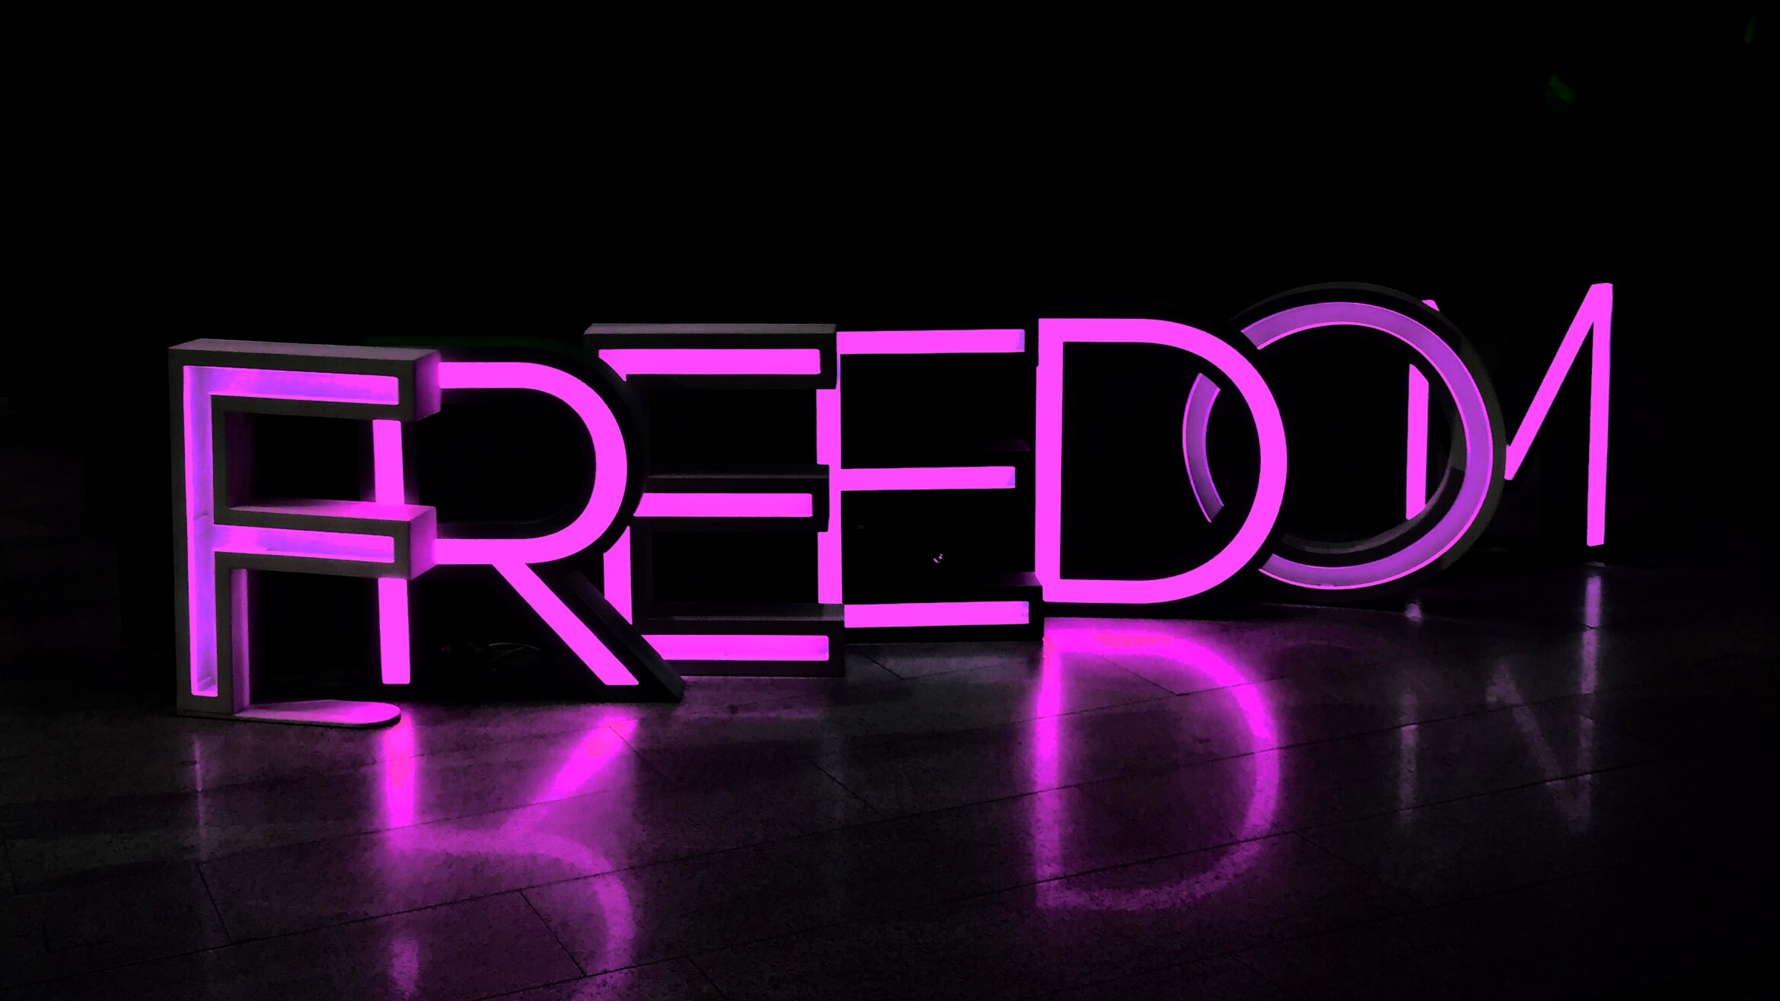
Photo by Kristina V on Unsplash
Notes:
The Culture is built on academic freedom and autonomy

Slide 34


Project Sponsor
The Rest of Us
Photo by Katherine Chase on Unsplash
Notes:
How does that translate into administration?
Problem: Project Owner Focused on Their Own Problems

Slide 35
Architect
University
Solution
Unit / Faculty
IST
Customer
Developers
Notes:
Solution: Represent the University in a 3-way conversation

Slide 37

Photo by Hannah Busing on Unsplash
Notes:
Architects (ideally) bring everyone together to consider the “bigger picture” and present the issues of ignoring that higher level perspective

Slide 38
IT Projects at UManitoba
Plan
Estimate Cost & Effort
Project Proposal
Acquire Funding
Build
Finalize Solution
Implement
Define Support
Run (Maintain)
Minor enhancements, fixes, and upgrades
Support customer
Notes:
Describe role in each phase of project (Plan, Build, and Run)
Plan: Pre-Committee Work (Risk Identification), Build Trust
Build: Architecture Exceptions and Decisions, Guard Rails / Sandbox
Run: TTP, TTO, Inform Next Project

Slide 39

Photo by CHUTTERSNAP on Unsplash
Notes:
Goal of the cycle is to make success repeatable, while maintaining independence.

Slide 40


Photo by david latorre romero on Unsplash
Photo by david latorre romero on Unsplash
Notes:
Problem: Projects don't last forever, but the code and technology does.
Part 3: Role of Governance in the long-term, AFTER the project is over

Slide 41

Notes:
Act 3: Governance, Standardization, and Awareness (Influence)

Slide 42
What would we do differently?
What are our next steps?
Terry & David

Slide 43

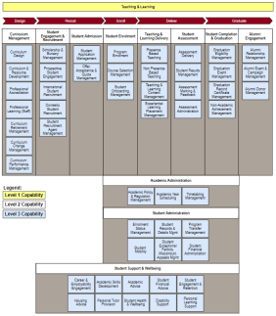
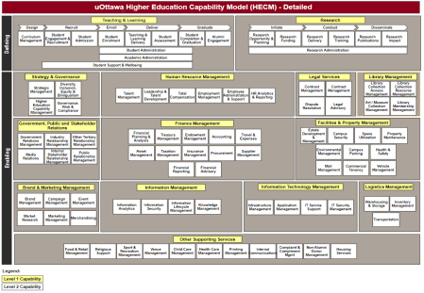

uOttawa’s Higher Education Capability Model (HECM)
Drill down to lower-level capabilities
Eodem modo typi, qui nunc nobis videntur parum clari
qui sequitur mutationem consuetudium lectorum. Mirum est notare quam littera gothica
odio dignissim qui blandit praesent luptatum zzril delenit augue duis dolore te feugait nulla facilisi. Nam liber tempor cum soluta nobis eleifend option congue nihil imperdiet doming id quod mazim
View capability definitions
Note: The uOttawa HECM is a modified version of industry reference models (CAUDIT, USICA, Info-Tech)

Slide 44
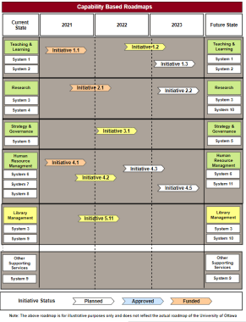
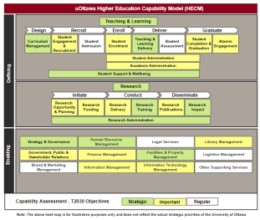
Capability Based Planning
CAPABILITY BASED ROADMAPS
Organized around business capabilities, linking strategy & execution
KEY BENEFITS
Alignment between IT investments and long-term business outcomes,
Proper scheduling of IT initiatives,
Better synchronization of business and IT related plans
STRATEGY
EXECUTION
BUSINESS CAPABILITY MODELS
Help business executives decide WHERE future IT investments should go.
CAPABILITY BASED ROADMAPS
Operate with planned IT initiatives and help business executives decide WHEN these investments should be made
Eodem modo typi, qui nunc nobis videntur parum clari
qui sequitur mutationem consuetudium lectorum. Mirum est notare quam littera gothica
odio dignissim qui blandit praesent luptatum zzril delenit augue duis dolore te feugait nulla facilisi. Nam liber tempor cum soluta nobis eleifend option congue nihil imperdiet doming id quod mazim

Slide 45
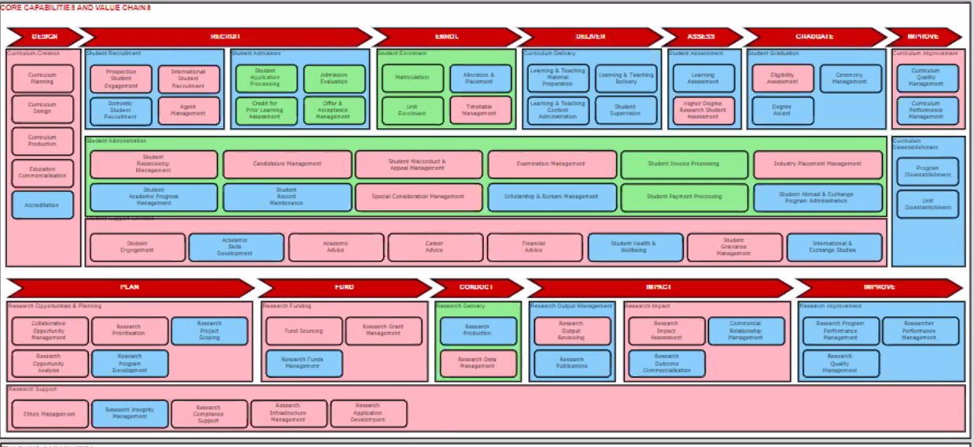
U of M Capability Map Concept

Slide 46
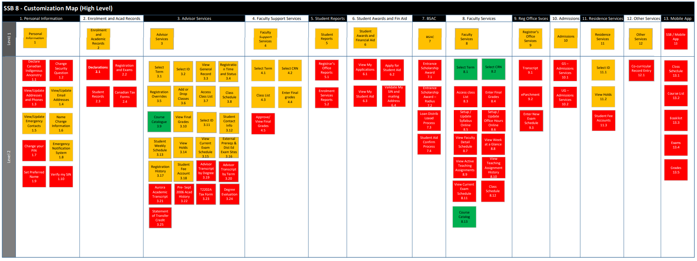
Baseline
Modifications
Customizations
Notes:
Example: Finance/SIS capabilities mapped to risk (custom, modded, baseline)

Slide 47

What did you (hopefully) learn?

Slide 48
What did you learn?
From the Macro-Level (Terry)
From the Micro-Level (David)
What a sustainable Architecture practice looks like
How to balance Architecture and project decisions
Power of Capability Models and Digital Moments
Represents the “big picture” and the “long term”
Informs Stakeholders and Governance Structures
Aims to provide standardization and awareness

Slide 49
To Be Continued
From Custom COTS to Cloud: A Case Study in Solution Architecture
  Tomorrow @ 1pm in A3
  They said it was impossible. They said it couldn't be done. They said they would never move our customized commercial off the shelf (COTS) application and move it into the cloud. They were not a Solution Architect. Learn what it takes to do the impossible and modernize your COTS development.

Slide 50
Who are "we" exactly?
Terry Bunio
David Wesst
Director, Planning & Governance at University of Manitoba
Role
  Translating vision into strategy
  Setting direction
Solution Architect, UManitoba
Role
  Implementing strategy and informing its evolution
  Implementing direction and aligning leading tacticians

Slide 51

Questions (and Thank You)
Notes:
Questions and topics in case we have time
Capability-Driven
Customer-Centric
Handling Exceptions
Operations & Project Conflict
“The Next Project” problem

